Slide 1

Python Course Chapter 9
Advanced Functions

Slide 2
First Class Objects
Python functions are first-class objects. A programming language has First-class functions if functions in that language are treated like other objects or variables.
Therefore, a function can be:
assigned to a variable.
passed as an argument into another function. (The same idea from Calculus or discrete math - composite function.)
returned by another function.
Put into a list, tuple, or dictionary.

Slide 3
First Class Objects
JavaScript, Python, and other programming languages treat functions as a first-class citizens; therefore, functions have the same privilege as strings, numbers, and other objects.
On the other hand, in Java or C++, functions are second-class objects. Therefore, none of the 4 points we mentioned are available in Java or C++.
A function that takes another function as an input is called a higher-order function.

Slide 4
Decorators
In Python, it’s very common to use a higher-order function to wrap a function. For example, we have:
def higherOrder(inner):
def func():
# some code
inner()
# some code
return func
def someFunc():
# somecode
finalFunc = higherOrder(someFunc)
finalFunc()

Slide 5
Decorators
Python has a syntax sugar called decorator that allows us to simply this process:
def higherOrder(inner):
def func():
# some code
inner()
# some code
return func
@higherOrder
def someFunc():
# somecode
someFunc()
This is the decorator.
With the help of decorator syntax sugar, we can just invoke the function directly.

Slide 6
Decorators
Decorators are very useful in Python frameworks. For example, Flask is a Python framework that allows us to build a web server with simple codes.
Traditionally, we have to set up TCP and HTTP protocols to have a well-functioning web server. In Flask, we just need to use the decorator it provides; then, everything else will automatically be done!

Slide 7
Generator
Recall the generator syntax that we learned from chapter 3. (The one that is very similar to comprehension.)
However, we need a better (or general) way to create a generator. When defining a generator, a yield statement is used rather than a return statement.
Also, in Python 3.3, they introduced a new keyword yield from. Yield from works just like yield, but it only passes the generator into another generator.

Slide 8
Iteration, Iterable, and Iterator
Iteration is a general term for taking each item of something, one after another. Any time you use a loop, explicit or implicit, to go over a group of items, that is iteration. Iteration is just a concept.
According to the Python documentation, an iterable is an object that has an __iter__ method which returns an iterator, or which defines a __getitem__ method that can take sequential indexes starting from zero (and raises an IndexError when the indexes are no longer valid).
An iterator is an object that has __iter__ method that returns self (because the __iter__ method is always supposed to return an iterator), and has __next__ method implemented. *. Python generator is also an iterator.

Slide 9
Iteration, Iterable, and Iterator
When an iterable object is passed as an argument to the built-in function iter(), it returns an iterator for the object. (Python automatically does this for us.)
When using iterables, it is usually not necessary to call iter() or deal with iterator objects ourselves. The for statement does that automatically for us, creating an unnamed temporary variable to hold the iterator for the duration of the loop.
Therefore, the secret mechanism of for loop behind the scene is - Python for loop creates an iterator object and executes the next() method for each loop.

Slide 10
Stdin, Stdout, and Pipe
When executing Python codes in the terminal or command prompt, it’s very common to use stdin (standard input), stdout (standard output) and pipe.
In Python, input() and print() can be used to take stdin and stdout; however, we can also redirect them. If we redirect our output to a file, then we are able to write the result of a program to a file. With the same idea, we can redirect a file as our input.
Therefore, our program has the ability to read and write to a file through command line arguments.

Slide 11
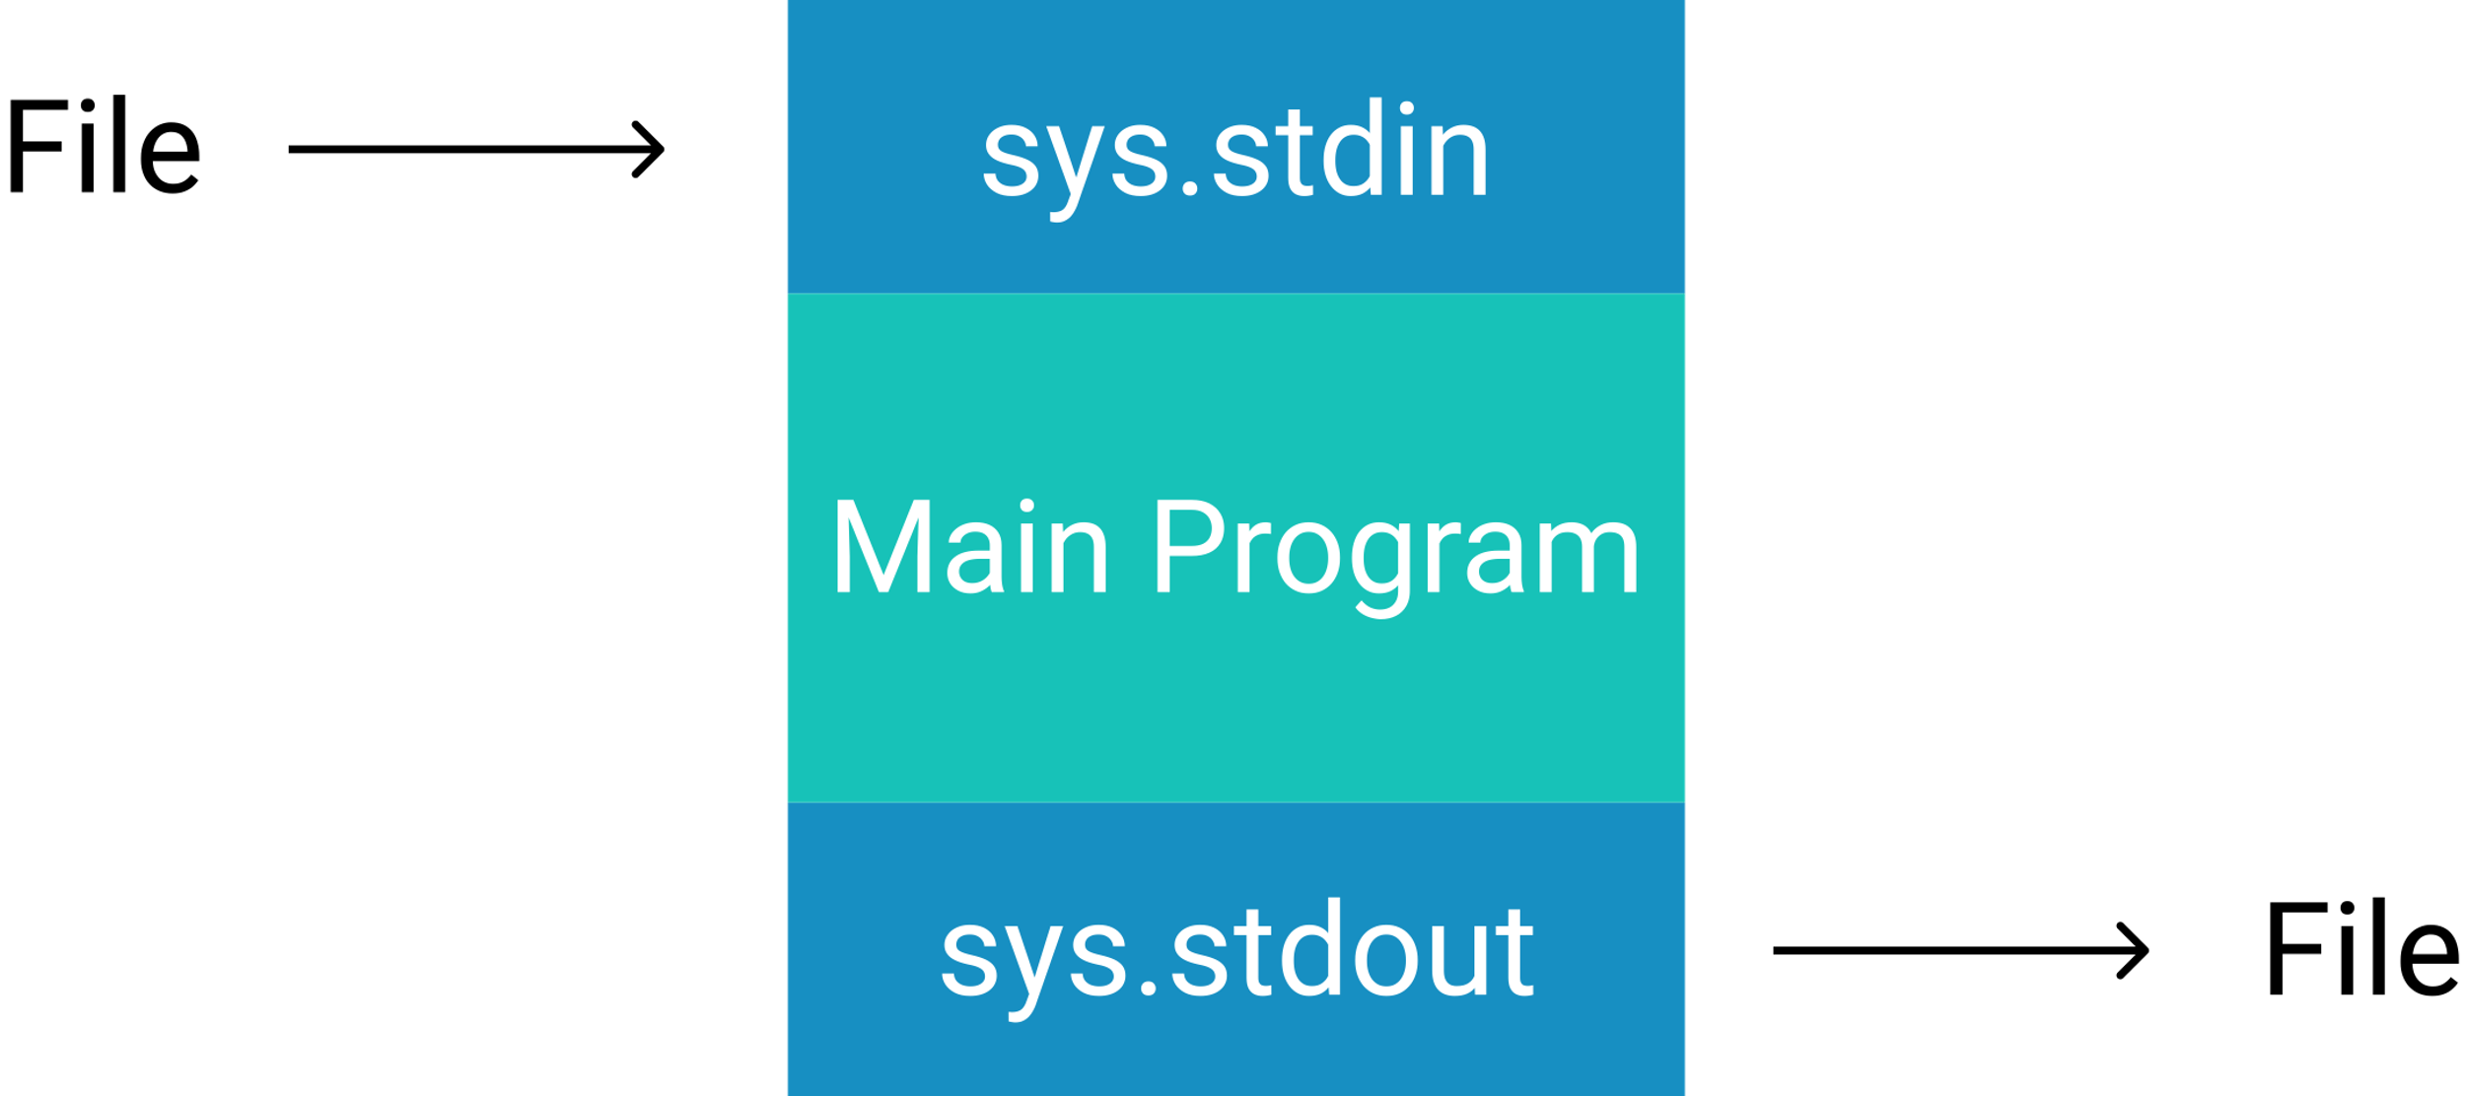
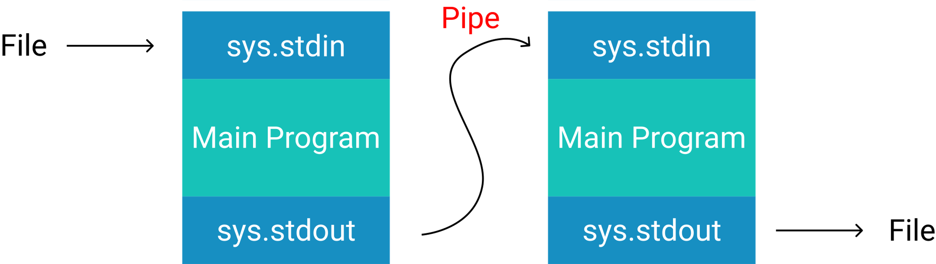
Stdin, Stdout, and Pipe
>, <, and >> are used to redirect the standard input, and output.
> means to overwrite.
>> means to append.
< means to read.
Also, we can use the pipe functionality to transfer an output of a program to be an input of another program.

Slide 12
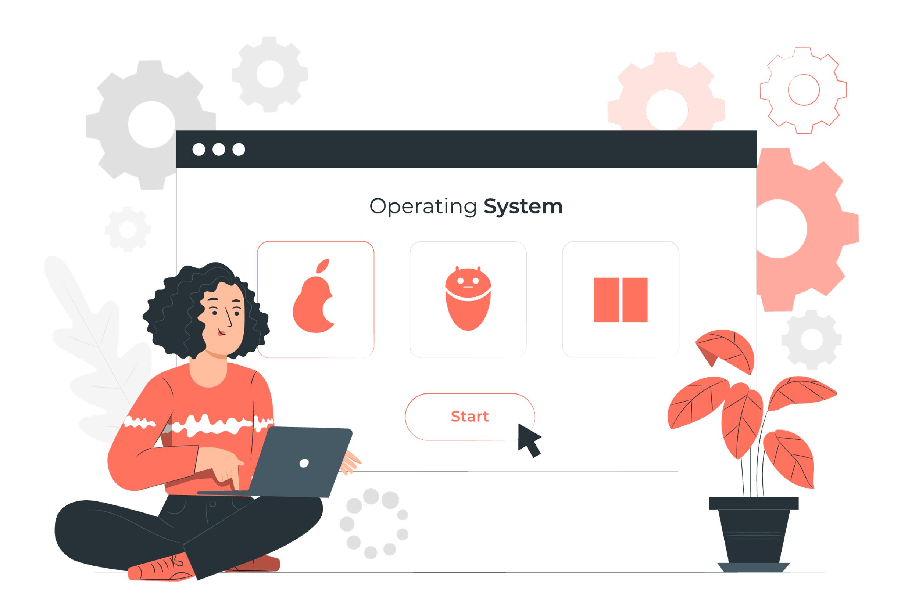
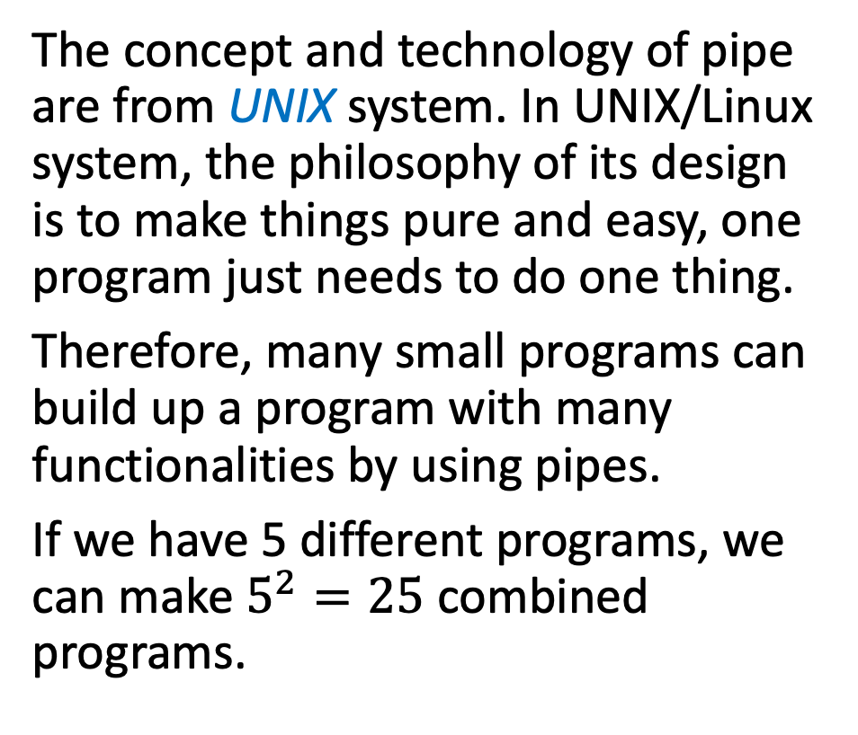
Stdin, Stdout, and Pipe
The concept and technology of pipe are from UNIX system. In UNIX/Linux system, the philosophy of its design is to make things pure and easy, one program just needs to do one thing.
Therefore, many small programs can build up a program with many functionalities by using pipes.
If we have 5 different programs, we can make $5^{2}=25$ combined programs.

